Slide 1
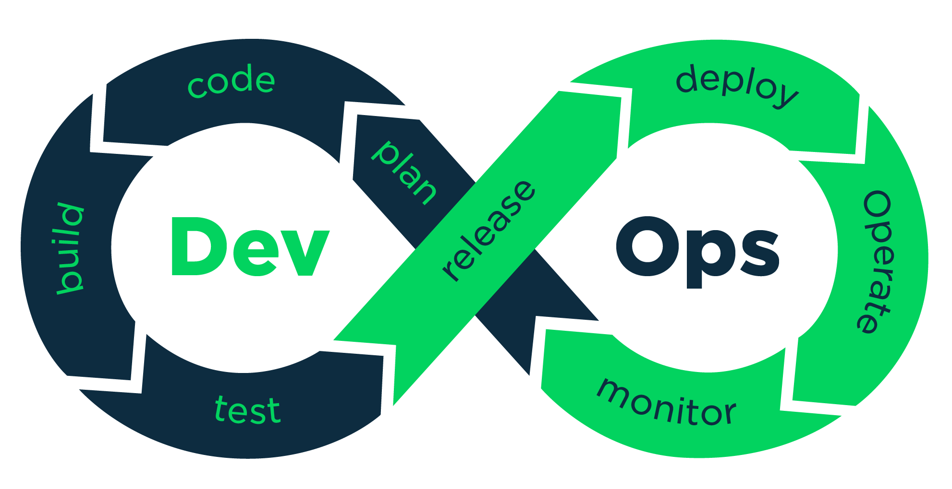

Jenkins Plugins
Install GIT & GITHub Plugins

Slide 2
Jenkins : Maven Base Job
Check-Out Source Code.
Compile the Code
Run the Tests
Package the Project.

Slide 3


